Slide 1
DATA 601 – Working With Data and Visualization
Final Presentation
Winter 2025
Ruby Nouri Kermani (30261323)
Joao Ricardo Bertti Targino (30271085)
2025-02-13

Slide 2
Introduction
Our project aims to explore the data regarding the ongoing Substance abuse crisis that Canada (and the World) is going through.
The data used for these analysis are from 2016 (Opioids) and 2018 (Stimulants) up to 2024 (June).
Our purpose is to gather insights while using techniques and tools that we learned over the course of 6 weeks.

Slide 3
Guiding Questions
To help us understand the situation, we aimed to answer some Guiding Questions:
What is the growth percentage of incidents by Province from 2016 to 2023?
Is there a specific group (Age, Sex) in which the growth was more prevalent?
Is the weather relevant for the number of incidents?
What is the share of intentional deaths/hospitalizations overall? Is it increasing or decreasing?
Throughout the development process, we also explored additional questions, such as:
Regarding Question 4, what is the difference if we deep-dive by Age Groups and Gender
Can we draw a correlation between homicides/crime rate and substance abuse?

Slide 4
Datasets
We used two main datasets to perform the analysis:
Opioid- and Stimulant-related Harms in Canada: publicly available and maintained by Health Canada, updated every 6 months.
Incident-based crime statistics, by detailed violations, police services in the Atlantic provinces: publicly available and maintained by Statistics Canada (with data from Provincial Police Services).
Although we aimed to include data on Drug Trafficking, we couldn't find reliable public sources, so we focused on these two datasets to ensure replicability and transparency.

Slide 5
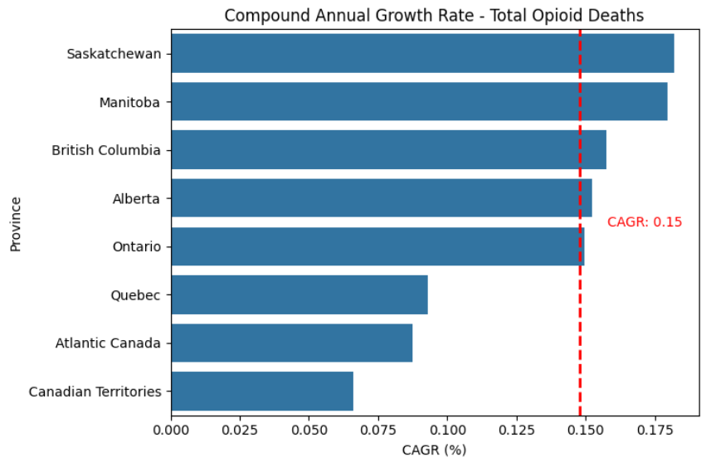
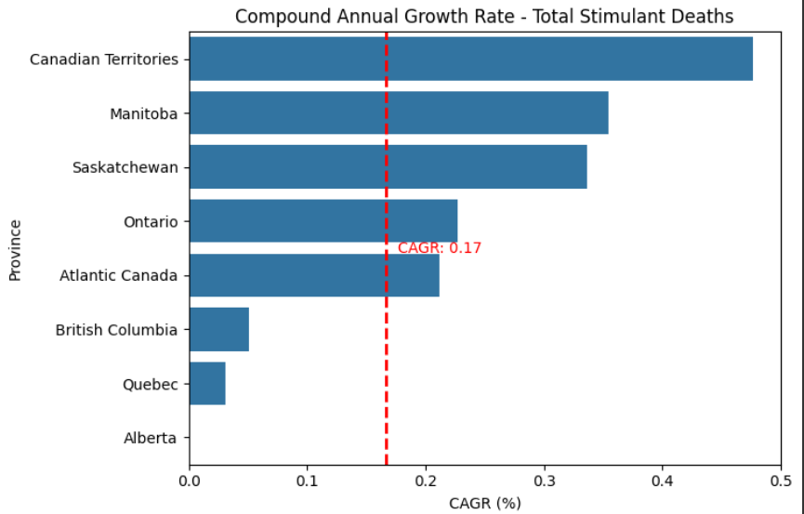
Guiding Question 1
Is there a specific group (Age, Sex) in which the growth was more prevalent?
To answer this question, we computed the Compound Annual Growth Rate (CAGR) of each Province over the last years. This metric is useful when you have non-sequential data (i.e: one year is independent of the other).
Opioids: The highest growth in opioid deaths occurred in Manitoba and Saskatchewan, with a CAGR of about 17.5%, much higher than Canada’s CAGR for opioid deaths from 2016 to 2023 was 14.8%.
Stimulants: similarly, stimulant-related deaths were notably higher in Central Canada, where growth rates exceeded 30% while Canada’s stimulant death growth was about half that rate. BC and QC were exceptions, with growth rates under 5%.

Slide 6
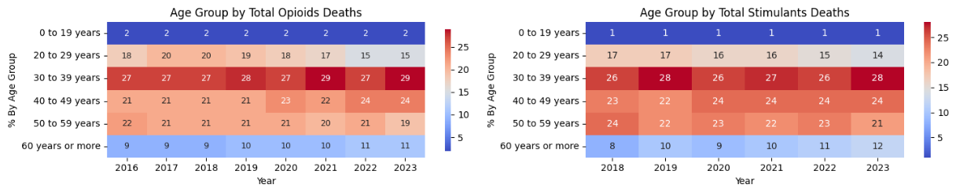
Guiding Question 2
Is there a specific group (Age, Sex) in which the growth was more prevalent
The data indicates that individuals aged 30 to 39 years are the most affected, followed closely by those aged 40 to 49 years. Notably, the presence of young adults (0–19 years) in these statistics is concerning, with 2% of opioid-related cases and 1% of stimulant-related cases.
Given the overall rise in substance-related deaths, the increasing impact on both older adults and younger individuals is a significant public health concern.

Slide 7
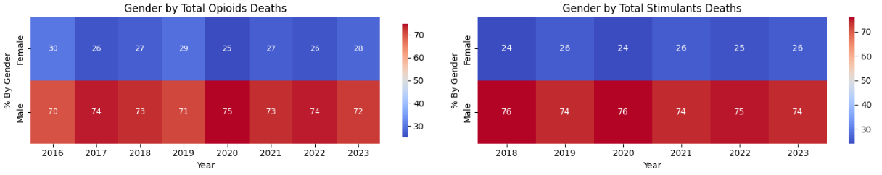
Guiding Question 2
Is there a specific group (Age, Sex) in which the growth was more prevalent
There is a clear male predominance in substance-related deaths, with males consistently representing over 70% of cases. While opioid-related fatalities among females declined slightly from 30% in 2016 to 28% in 2023, the opposite trend is observed for stimulants, where the proportion of female cases increased from 24% in 2018 to 26% in 2023.
In response to Guiding Question #2, the data confirms that males and middle-aged adults (30–39 years) remain the most affected groups.
However, there is also a notable rise in fatalities among older adults and young individuals, indicating a broadening impact across different demographics.

Slide 8
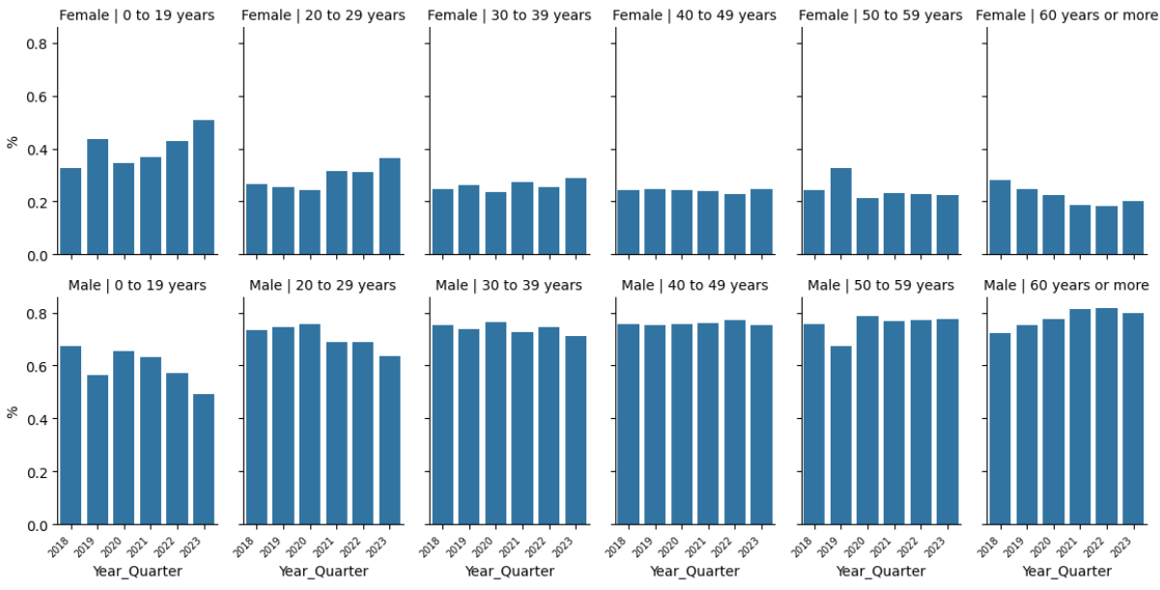
Guiding Question 2
Is there a specific group (Age, Sex) in which the growth was more prevalent
Opioid Deaths Sliced by Gender and Age Group
The charts above illustrate that the 30-39 and 40-49 age groups are predominantly male, consistently accounting for over 80% of victims. This aligns with earlier findings on age and gender distribution.
However, the proportion of female victims in younger age groups has risen significantly in recent years.
In the youngest group, the female share increased from 25% to over 50%, while in the next group, it grew from 22% to nearly 40%.

Slide 9
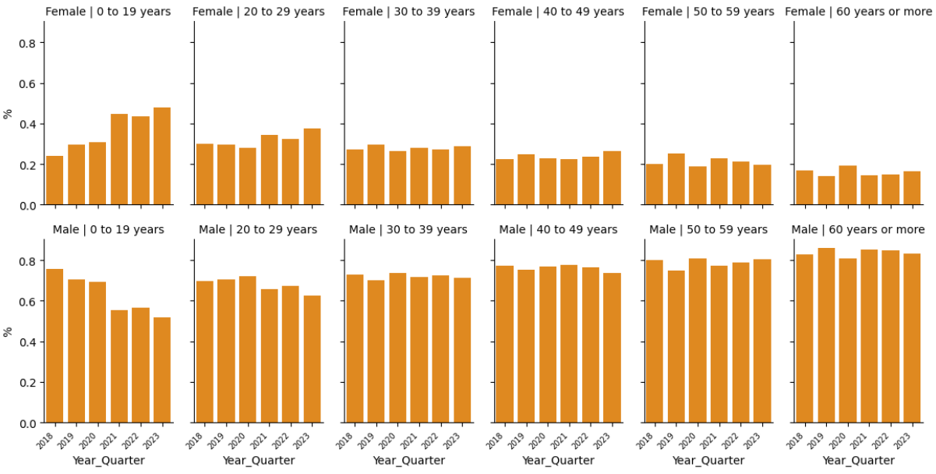
Guiding Question 2
Is there a specific group (Age, Sex) in which the growth was more prevalent
Stimulant Deaths Sliced by Gender and Age Group
Like Opioids, Stimulant-related deaths among females have increased in younger age groups.
The percentage of female victims in the 0-19 age group doubled, rising from 24% to 48.1%, while the 20-29 group saw an increase from 30% to 37%.
In contrast, other age groups remain largely male-dominated with consistent averages over time.

Slide 10
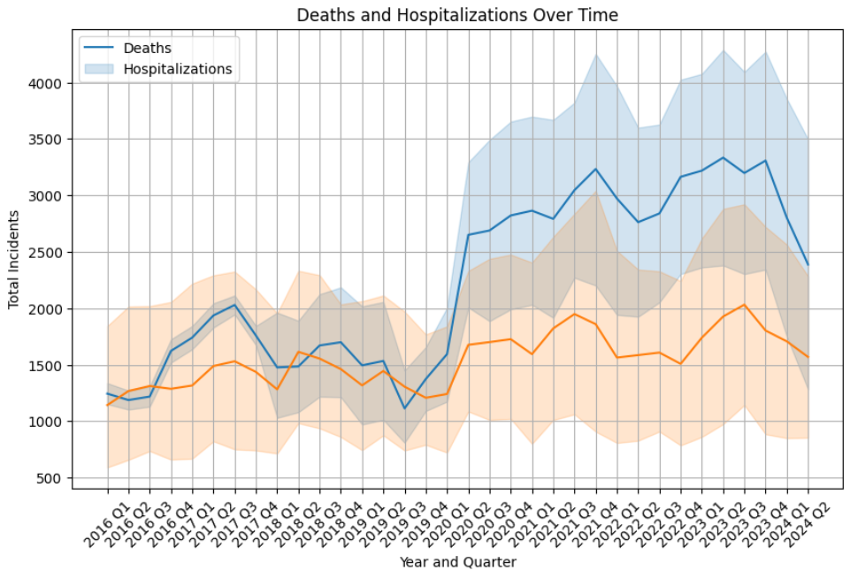
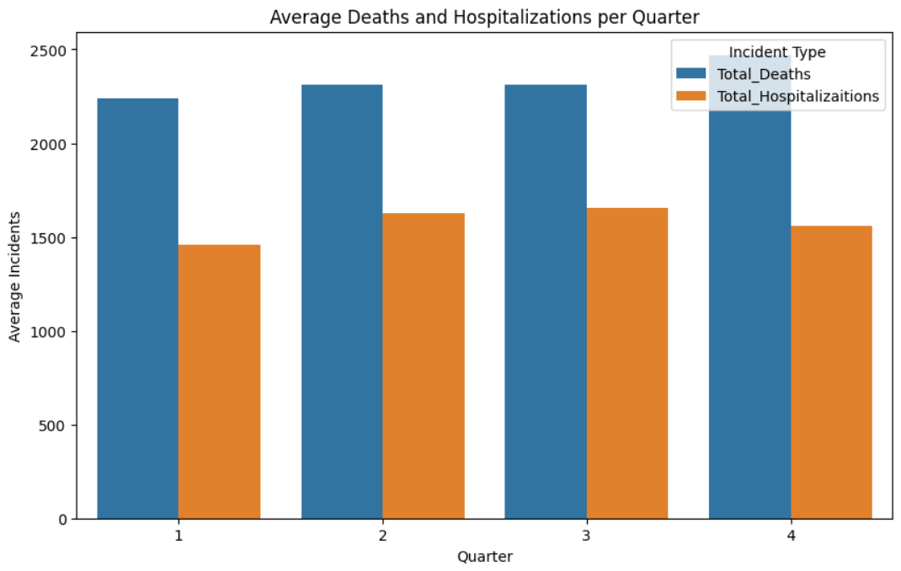
Guiding Question 3
Is the weather relevant for the number of incidents?
Q1 (January - March): Winter (cold, snow, shorter daylight hours)
Q2 (April - June): Spring (mild, transitioning to warmer weather)
Q3 (July - September): Summer (warmest, longer daylight hours)
Q4 (October - December): Fall (cooling temperatures, shorter daylight hours)
Death rate: Q4 > Q2 > Q3 > Q1
Deaths related to opioid and stimulant use are highest in the fourth quarter (October-December) and lowest in the first quarter (January-March).
Hospitalization rate: Q3 > Q2 > Q4 > Q1
Hospitalizations related to opioid and stimulant use are highest in the third quarter (July-September) and lowest in the first quarter (January - March).

Slide 11
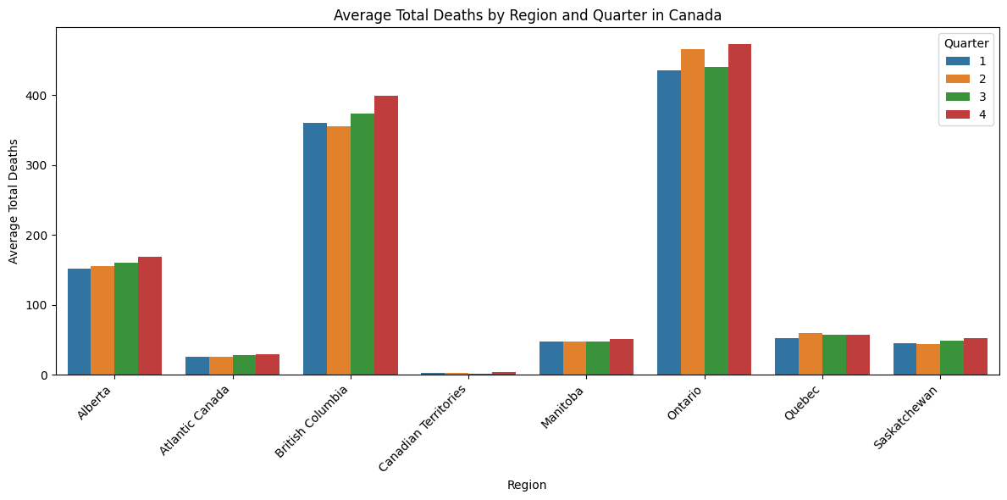
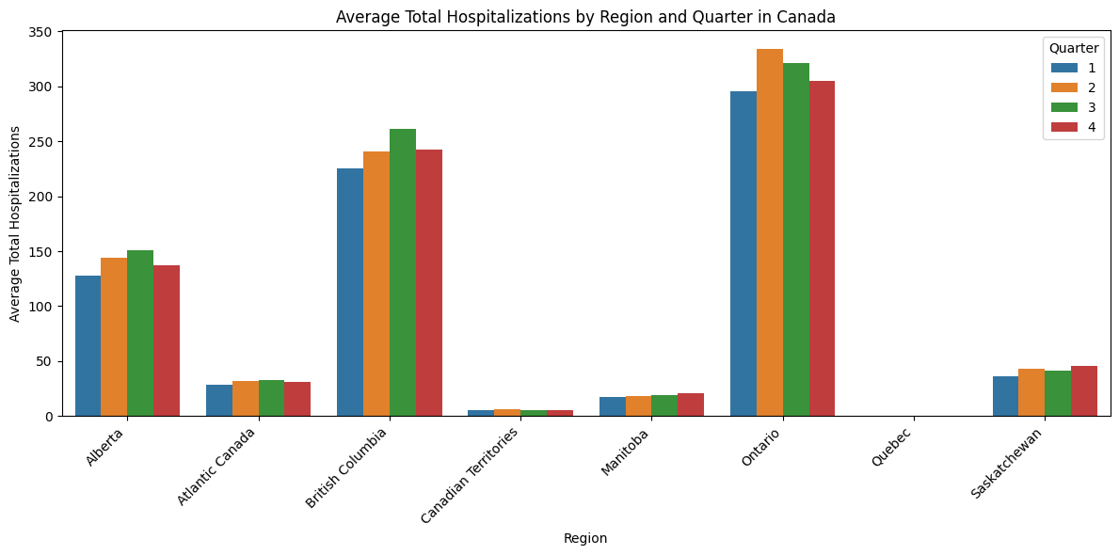
Guiding Question 3
Is the weather relevant for the number of incidents?
British Columbia and Ontario show the highest average death and hospitalization rates, indicating more severe crisis of opioids and stimulants compared to other regions.
Both plots exhibit some seasonal variations in deaths and hospitalizations, with deaths tending to peak in the fourth quarter (October-December) and hospitalizations often highest in the third quarter (July-September).

Slide 12
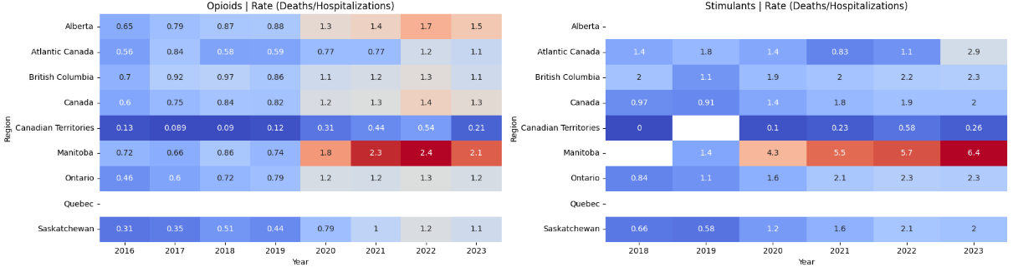
Guiding Question 4
What is the share of intentional deaths/hospitalizations overall? Is it increasing or decreasing?
The death-to-hospitalization rate is a critical metric for understanding the trajectory of this crisis.
While we observe growth in this rate (as shown on Guiding Question #1), a rate lower than 1 suggests that hospitalizations are outpacing deaths, offering a chance to save more lives.
For Opioids, in 2023, Manitoba had twice as many deaths as hospitalizations, while Alberta had a rate of 1.5.
The trend for stimulants follows a similar pattern, but with even more alarming figures, as All regions that reported data have a death-to-hospitalization rate higher than 2.
Manitoba stands out again as the most affected province.

Slide 13
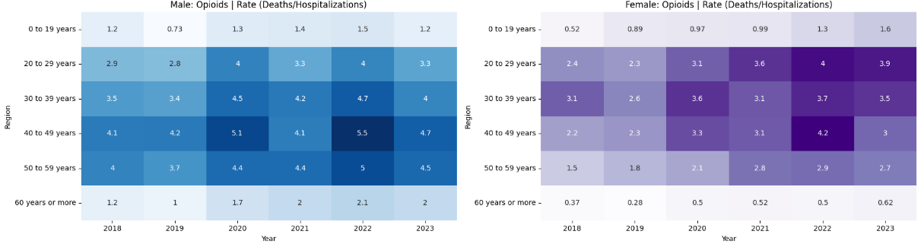
Guiding Question 5
What is the difference if we deep-dive by Age Groups and Gender?
Opioids
The death-to-hospitalization rate for males remains above 1 across all age groups, highlighting a severe issue within middle-aged.
For females, the trend is somewhat similar; however, peak values for females are significantly lower than those for males, which aligns with the 70/30 case distribution observed in Guiding Question 2.
One positive takeaway is the notable decline from 2022 to 2023, suggesting that public policies and interventions are having an impact.

Slide 14
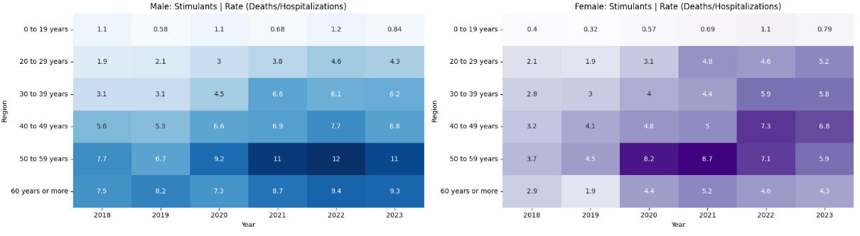
Guiding Question 5
What is the difference if we deep-dive by Age Groups and Gender?
Stimulants
The death-to-hospitalization rate for stimulants presents an even more alarming scenario.
Among males, the 50–59 age group has maintained a rate above 10 for the past three years, meaning that for every one hospitalization, there are ten fatalities.
A similar pattern is evident among females, where stimulant-related death rates surpass those of opioids, particularly in the oldest two age groups.
Unlike the trend observed with opioids, there is no significant decline in stimulant-related fatalities from 2022 to 2023, indicating that the crisis remains severe and unresolved.

Slide 15
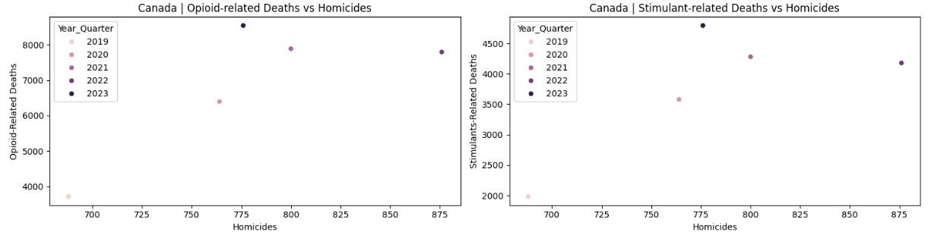
Guiding Question 6
Can we draw a correlation between homicides/crime rate and substance abuse?
Examining the data across Canada, we see that in 2019, the combined numbers were significantly lower compared to 2022 and 2023.
This suggests a positive correlation, as the numbers have increased together over time. A more insightful approach would be to analyze this trend at the provincial level for a clearer understanding.

Slide 16
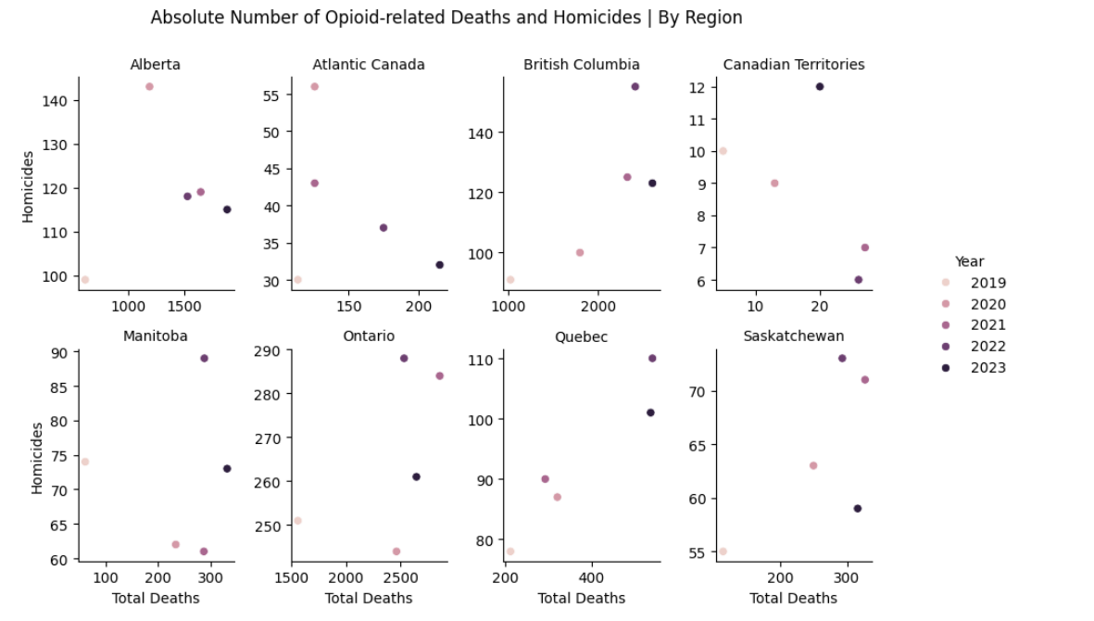
Guiding Question 6
Can we draw a correlation between homicides/crime rate and substance abuse?
Opioids
We can observe a correlation between gang-related homicides (a proxy for gang activity in a province) and substance-related deaths.
British Columbia, Ontario, and Manitoba presents clear spikes in both deaths and gang-related homicides in 2022 and 2023, highlighting this alarming trend seen in previous questions.

Slide 17
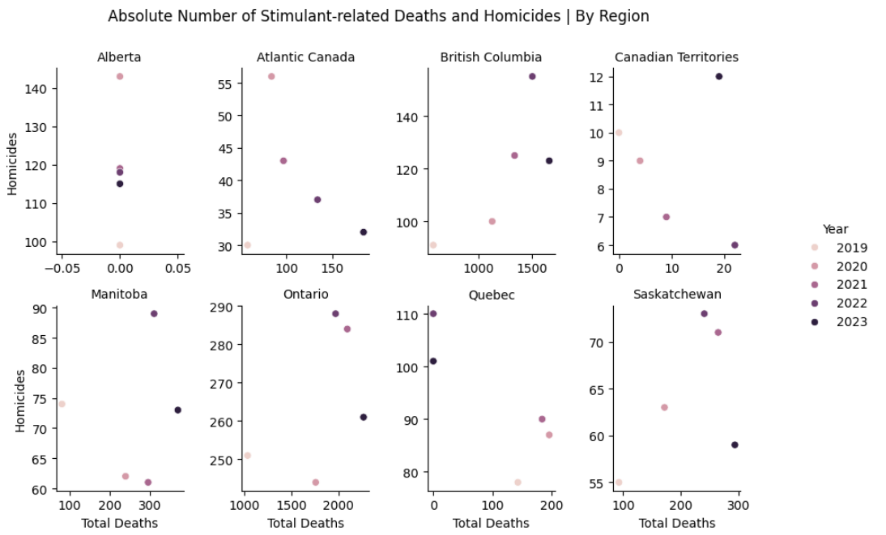
Guiding Question 6
Can we draw a correlation between homicides/crime rate and substance abuse?
Stimulants
Similarly with the previous slide, BC and ON registered spikes on the absolute number of Substance-related deaths and homicides.

Slide 18
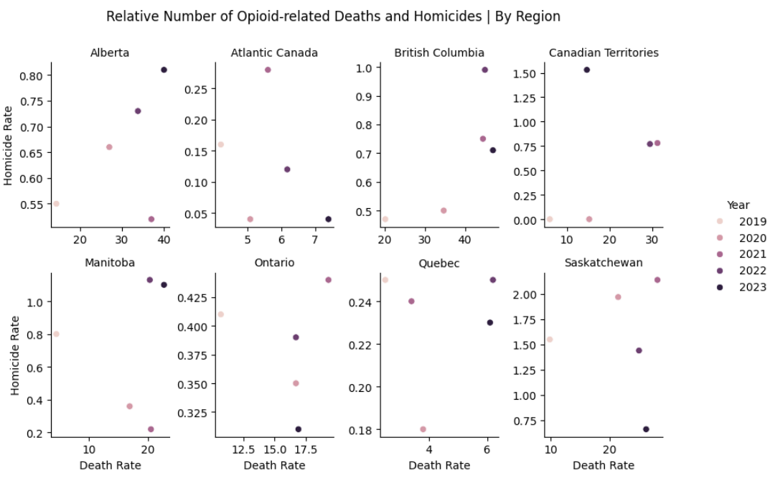
Guiding Question 6
Can we draw a correlation between homicides/crime rate and substance abuse?
Opioids
When normalizing the data by population size, new trends emerge:
Alberta experienced consistent growth in both metrics from 2020 to 2023.
Manitoba in contrast, saw a sharp increase in homicide rates in 2022 and 2023.
Saskatchewan, the Atlantic provinces, and the Territories, have been witnessing a decline in both metrics in recent years.

Slide 19
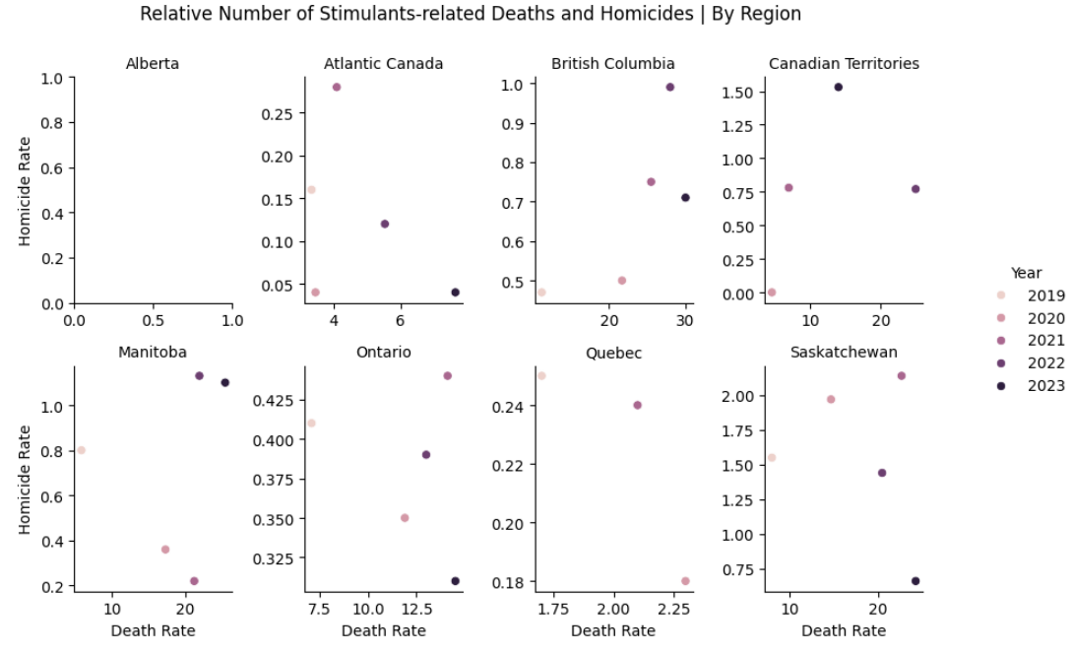
Guiding Question 6
Can we draw a correlation between homicides/crime rate and substance abuse?
Stimulants
When examining the relative data for stimulants, troubling patterns emerge once again.
Manitoba and British Columbia have seen an increase in both rates over the years, suggesting higher activity in these provinces.
Saskatchewan, Atlantic Canada, and Ontario (only in 2023) have experienced a decline in these rates.

Slide 20
Final Thoughts
The substance abuse crisis is widespread across Canada, with no clear indication that it has peaked or that current measures are effectively reducing the numbers.
There is a positive correlation between the growing number of deaths related to substance abuse and crime rates and homicides, leading to a growing sense of insecurity in society.
No final conclusions can be drawn, as the goal was to present data and gather insights.
On a technical note, the project highlighted the power of Python and its libraries to facilitate data storytelling, generate compelling arguments, and conduct in-depth analyses with a broad approach.

Slide 21
Thank you

